Slide 1
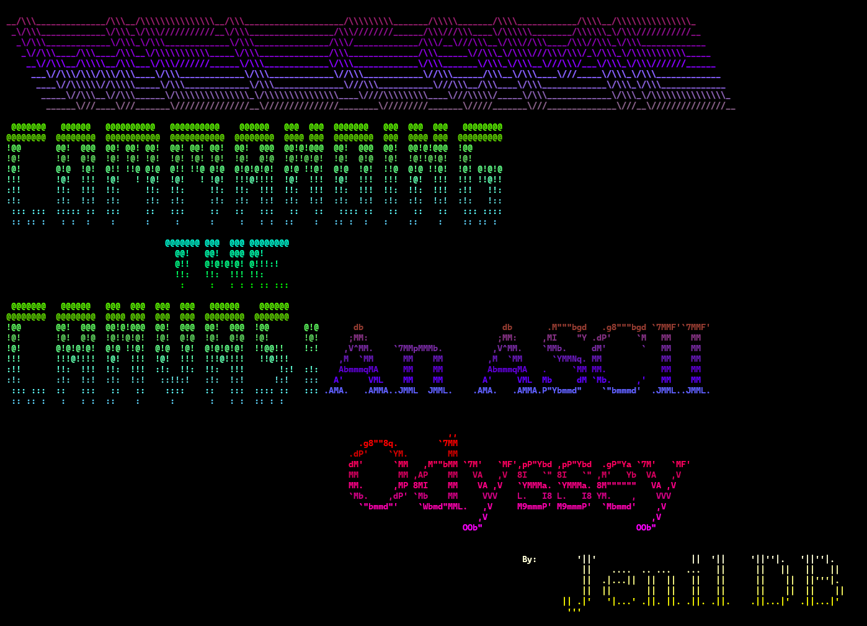

-: WELCOMES :-

Slide 2

Prepared by : Jenil Bathvar
Roll No. : 321
Enroll No. :23002171310064
Branch : CST
JAVA I

Slide 3
Commanding The Canvas:
An ASCII Odyssey

Slide 4
ASCII
A standard data-encoding format for electronic communication between computers.
ASCII assigns standard numeric values to letters, numerals, punctuation marks, and other characters used in computers.
American Standard Code for Information Interchange

Slide 5
ANSI color codes
ANSI color codes are a set of escape sequences used to control text color and formatting in terminal applications. These codes are typically represented as escape sequences beginning with \u001B[ followed by parameters for color, style, or other formatting options.
The basic ANSI color code \u001B[0m is used to reset all formatting to default, essentially turning off any applied colors or styles.
To convert ANSI color codes into a 255 color code format, the RGB values associated with the desired color are mapped to a 6x6x6 color cube, resulting in a total of 216 colors. The remaining 39 colors are grayscale values ranging from black to white. Each of these colors is assigned a unique index from 0 to 255. So, when converting an ANSI color code, the RGB values it represents are translated into the corresponding index in the 255 color code format. This allows for a wider range of colors to be represented in terminal applications compared to the basic ANSI color set.

Slide 6
Inheritance
A mechanism that allows a class to inherit properties and behaviors from another class.
It is a fundamental concept in OOP that promotes code reuse and establishes relationships between classes.
in OOP

Slide 7
this keyword
The most common use of the this keyword is to eliminate the confusion between class attributes and parameters with the same name.
The this keyword refers to the current object in a method or constructor.

Slide 8

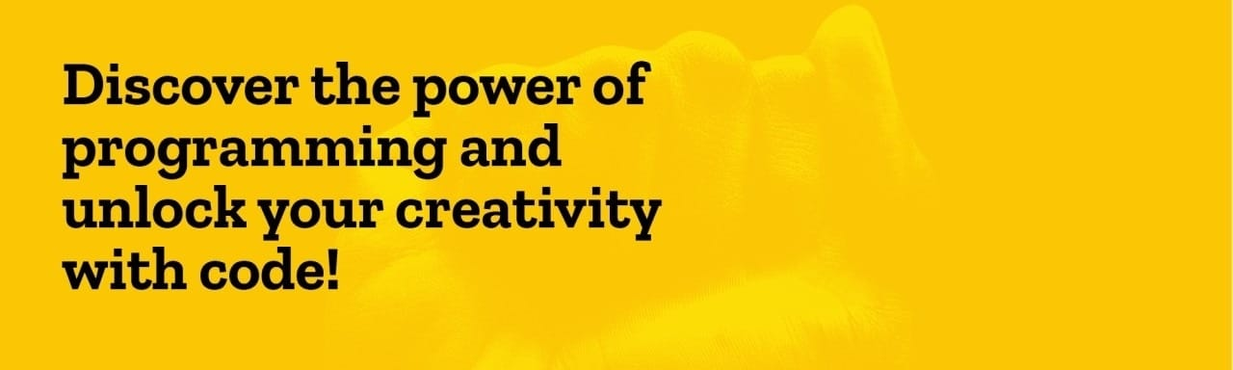
CREATIVITY
THIS TYPES OF INTERESTING PROJECTS MAKES LEARNING ANY NEW PROGRAMING LANGUAGE MUCH EASIER AND MEMORABLE

Slide 9
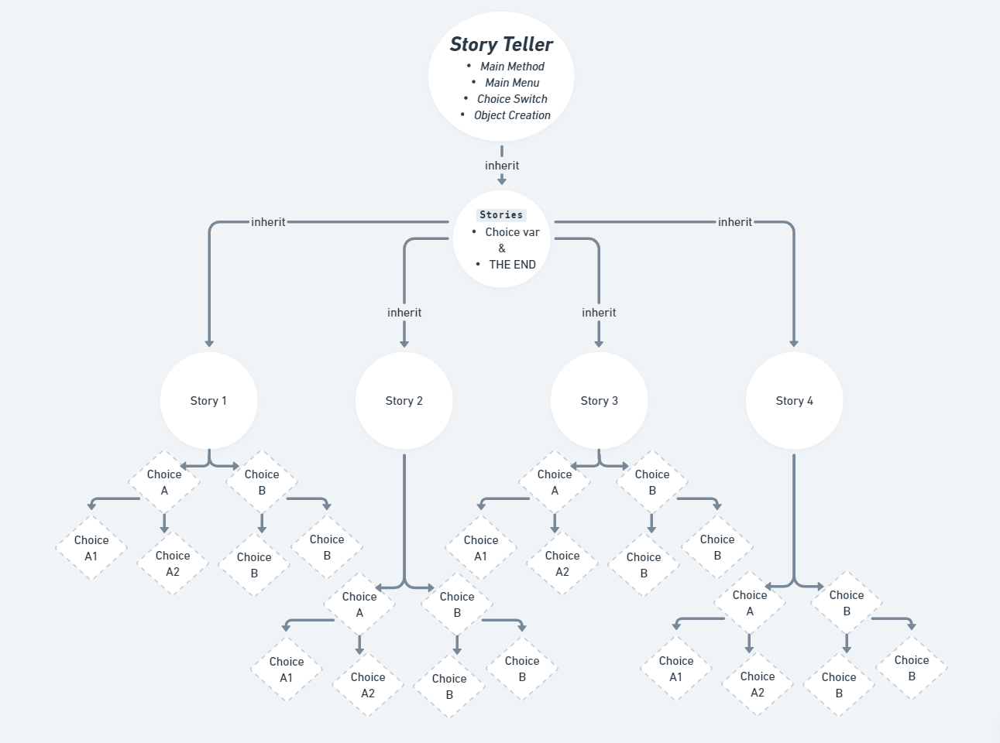
FLOW

Slide 10
Bibliography :
For ASCII Art conversion
https://patorjk.com/software/taag/
www.quora.com
www.reddit.com
https://stackoverflow.com

Slide 11


